Slide 1
QA to QE Transition

Slide 2






IT Disruption
Objectives
Time to Market
Cost Reduction
Quality Improvement
Increase Predictability
Solution Levers
Point of Departure
Point of Arrival
Traditional QA
Regression test Automation
Increase in test cycles
Guardian of functionality
Waterfall methodology
Higher QA/IT Cost
Agile Adoption
QA to QE Transformation
Technical QE team
End-To-End Automation
Reduction in test cycles
Guardian for Customer Experience
DevOps maturity
Reduction in COQ
Innovation & Continuous Improvement
Digitization
Future Ready Test Organization
Governance
Dev Ops & CI/CD
Mainframe Emulation
Test Data
Automation
Service Virtualization
Early Testing
Agility

Slide 3
Quality Assurance vs Quality Engineering
Typical SDLC Flow
Requirements
Design
Development
Test
Release
Benefits
Earlier defect detection through Shift Left and Increased, early automation
Increased velocity of delivery through reduced test cycle times from higher levels of automation
QA will be enabled effectively through out the SDLC life cycle
Shift Left
Number of Defects
QE Driven Life Cycle
Typical Life Cycle
Time
Quality assurance
Tester
Silos across Teams
Defect and Test Metrics
Silos across Teams
Quality engineering
Role Transformation
Process Transformation
Metrics Transformation
Tools and Infrastructure
“Assures" quality in the process and the product
Prevent defects by infusing assurance early in the SDLC
Quality Engineer
Standardized & Agility
Real Time Dashboards & Monitoring
Dev Ops, SV & Governance

Slide 4
QA to QE Plan
QA Tester
Dev Team
Build Team
QA Tester
Mature
QA team
Requirement Analysis
Coding
Version Control
Maintenance
Unit Testing
Code coverage
Code Movement
Build Deployment
Functional Testing
Regression Testing
Integration Testing
Develop End to End scripts
Measure DevOps maturity
Adapt new frames like DDD
Create Code driven testing
Implement
Plan
Feasibility
Automate
Test
Requirement Analysis
Automation Feasibility
Identify tools
Identify reuse components
Build/Customize Framework
Record/Script Functional Testing
Customize the scripts and Execute
Check –in Code to code repository
Verify test results and generate report
Pilot
Based on business priority implement the transformation for other assets
Create reusable components
Develop framework for automation, DevOps and SV
QE team
Learn
Quality Engineer
Dev Team
Quality Engineer
Identify tooling strategy & toolset
Identify asset for Pilot
Implement POV
Build, measure and publish metrics, digital dashboards
Upskill QA (Automation, SV, DevOps)
Create a Smart Team
Assign Mentors
Analysis AS IS state & create roadmap/stories

Slide 5
QA to QE – Team Composition
TCS in collaboration with “US Large Payer” envisioned to transform traditional Quality Assurance team to Quality Engineers by devising a comprehensive training plan and roadmap with achievable targets.
Baseline Data
Current Data
Target Data
3% - New Talents from
TCS Pool
10% - New Talents from
TCS Pool
97% - Existing Team
90% - Existing Team
100% - Existing Team
Test Automation – 16%
Test Automation
Test Automation
Test Automation – 40%
Current State
Future State
DevOps
Service Virtualization
DevOps
Service Virtualization
DevOps – 4%
Service Virtualization – 6%
DevOps – 15%
Service Virtualization – 25%
Note: % Indicates the number of Intermediate and Experts in the respective work streams

Slide 6

QE Initiatives
Challenges
Key QE Initiatives
Business / Strategic Benefits
Late Defects identification in SDLC/STLC
Last Minute requirements/Code changes
Static testing of requirement documents
Static Code Analysis (SonarQube/Fortify)
Unit Test Automation (jUnit, Cucumber)
Bi-directional traceability metrics
Functional Automation
Defects
17%
>$2M
Productivity improvement
Savings thru Productivity Improvement
Test Data
Data gaps between Production & Tests
Replication of Production scenarios in Test Regions
Tools Integration for data mining
Maintain reusable test data repository
Masked Production Data for Test usage
> 97%
IMPROVED
MTTR
Pockets of Standalone Automation Testing
Batch/Schedule Dependencies
Applications running on different platforms & technologies
Late Code Changes leading to huge Regression testing
Automated E2E Workflow Testing (QTP, Selenium, DVO, DevTest)
Script less Automation (UFT, Selenium & DevTest)
In-Sprint Automation (UFT, Selenium, DVO & DevTest)
Defect Removal Efficiency
Automation
>$1.6M
50%
Interface application dependencies
High volume of Integration issues across applications
Virtual Service for Developers & Test Teams (DevTest)
Service Catalogue for Enterprise usage
Reduction in Test Data turnaround time
Savings thru Automation &
Utility tools
Interface
100%
19%
Standalone Adhoc Reports on demand for different users
Huge Manual effort for generation of customized reports
Centralized Metrics Reporting
One Stop Reporting portal for QE Metrics, Financials and Executive Level reporting
SLA Commitments
Met
Overall QA to IT cost
Ratio
Reports

Slide 7
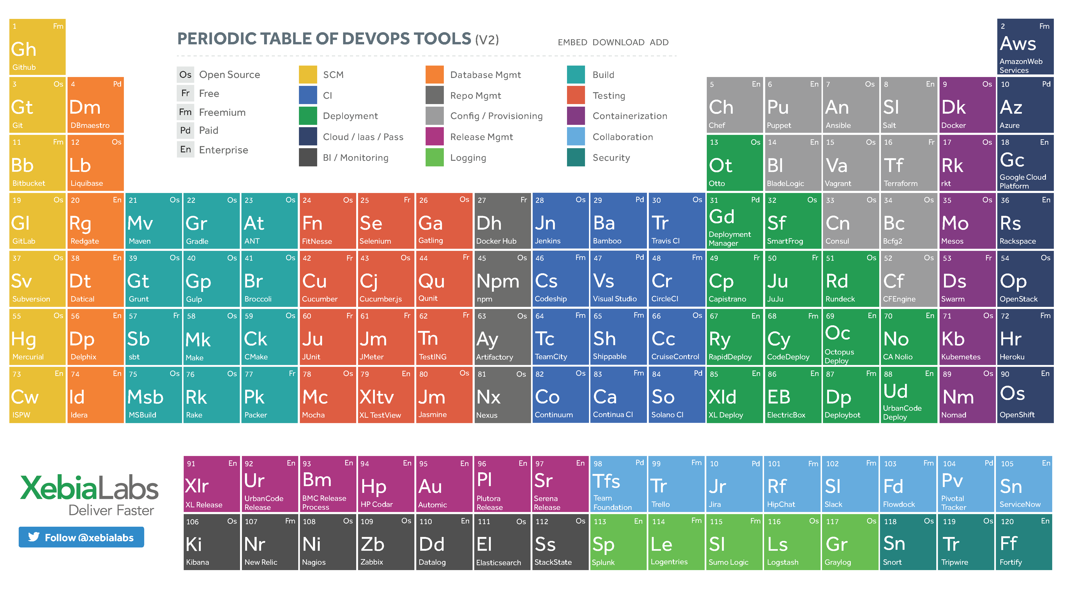
DevOps Tool Chain
Link: https://xebialabs.com/periodic-table-of-devops-tools/

Slide 8
Appendix

Slide 9
Approach | QA to QE
Skill Enhancement
Tools and Automation Feasibility
Automation PoC
Automation Script Development
T
R
A
N
S
F
O
R
M
A
T
I
O
N
Automation Test Suite
Manual Testers
1
Automation Process
1
Functional Knowledge
2
Automation Tool KT
2
Domain Knowledge
3
Automation Standards
and Guidelines
3
Manual Testing
4
Automation Executions
4
Testing Process
1
Faster Automation
2
Knowledge Utilization
3
Better Utilization of Time and Resources

Slide 10
Key Initiatives
Quality Engineering involves a set of Quality Assurance practices deploying state of the art techniques and tools to achieve desirable outcomes at each phase of Software Development Life Cycle (SDLC) by engaging QA.
Test Automation
Script less Automation
(UFT, Eggplant, Selenium & DevTest)
Enterprise Dashboard
Service Virtualization
Continuous Integration initiative in all Assets (Jenkins/Cloud-bees)
Static Code Analysis (SonarQube/Fortify)
DevOps
Virtual Service for Developers
(DevTest)
Service Catalogue for Enterprise usage
Unit Test Automation (jUnit, Cucumber)
Environment Monitoring
Private Cloud environment for QA
In-Sprint Automation
(UFT, Selenium, Eggplant, DVO & DevTest)
Enable ITS Tool for Automation
Automated E2E Workflow Testing
(QTP, Selenium, Eggplant, DVO, DevTest)
Tool Independent Frameworks
(UFT & Selenium )
Autonomation with new Open source tools (Sikuli & Renorex)
Custom template/framework for Java & .NET stack application
Automated Smoke Test and Regression Scripts pipelined with Development CI Jobs
Binary Code Artifact Management Assets (Nexus)
Automated Deployments using uDeploy
Functional QA Process
Build Regression Test Strategy
Maintain reusable test data repository
Promote lean testing
Bi-directional traceability metrics
Feasibility study for implementing Structural quality analysis using tools such as CAST SQG
Model based test design
Static testing of requirement documents

Slide 11



Quality Engineering Roadmap
Challenges
Solutions
Business Value
Late Requirement/Design Defects during Integration
Data gaps between Production & Tests
Replication of Production scenarios in Test Regions
Interface application dependencies
Pockets of Standalone Automation Testing
Batch/Schedule Dependencies
Shift Left QA Process – Ideation to Implementation
Centralized Metrics Reporting
Tools Integration for data mining
Masked Production replicated test Data
Enabling End to End Automation Pipeline via CI tools
Preparing the QE team to adopt to DevOps Practices
Identification of Defects early in the test lifecycle
Trim Down costs through quality process adoption
Empowered QA team to perform technical checkouts and code analysis
Side-by-side testing for consumers with current and future state applications
Perform unattended automation for application functionality post deployments
Technology
Mainframes
Java
ETL
SOA
DB2
Oracle

